Slide 1

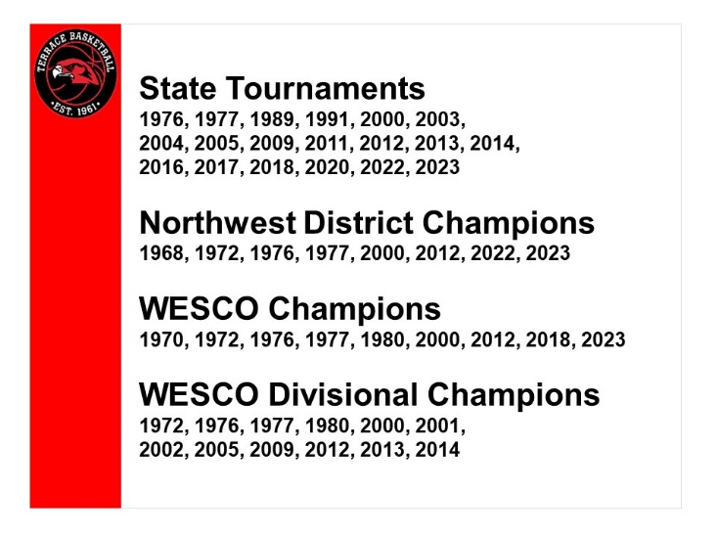

2022-2023
Mountlake Terrace High School Boys Varsity Basketball

Slide 2
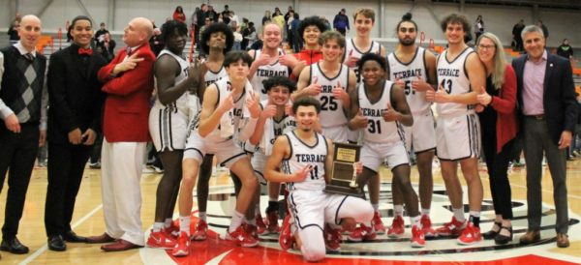
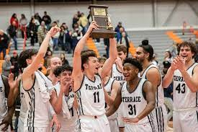
2023 FINAL EIGHT-WIAA 3A STATE TOURNAMENT
2023 NORTHWEST DISTRICT CHAMPIONS
2023 WESCO LEAGUE CHAMPIONS

Slide 3


Slide 4
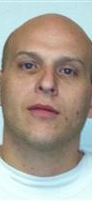

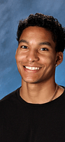
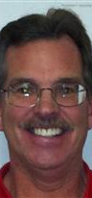
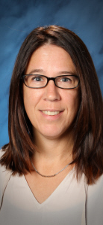
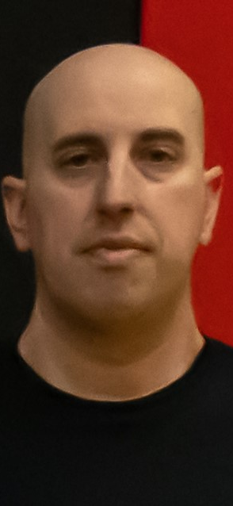
MTHS 2022-2023
COACHING STAFF

Slide 5
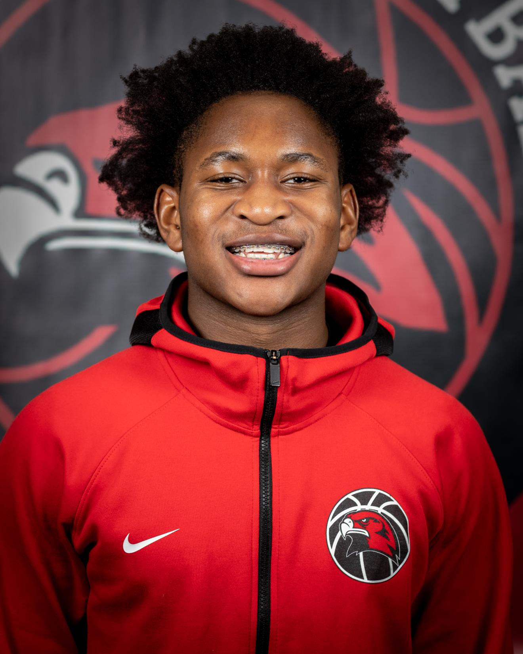
RAYSHAUN CONNOR

Slide 6
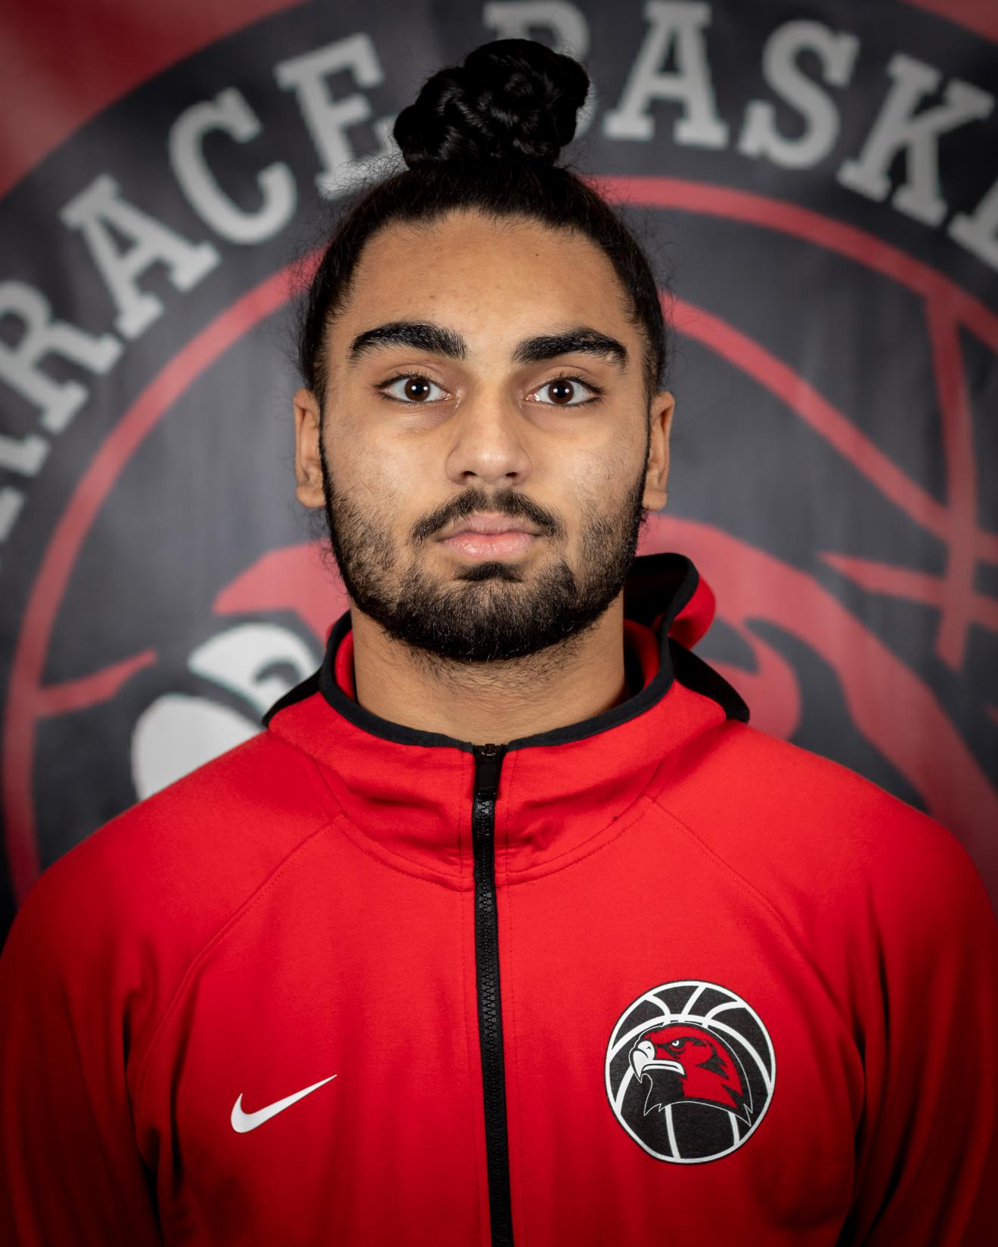
SVAYJEET SINGH

Slide 7
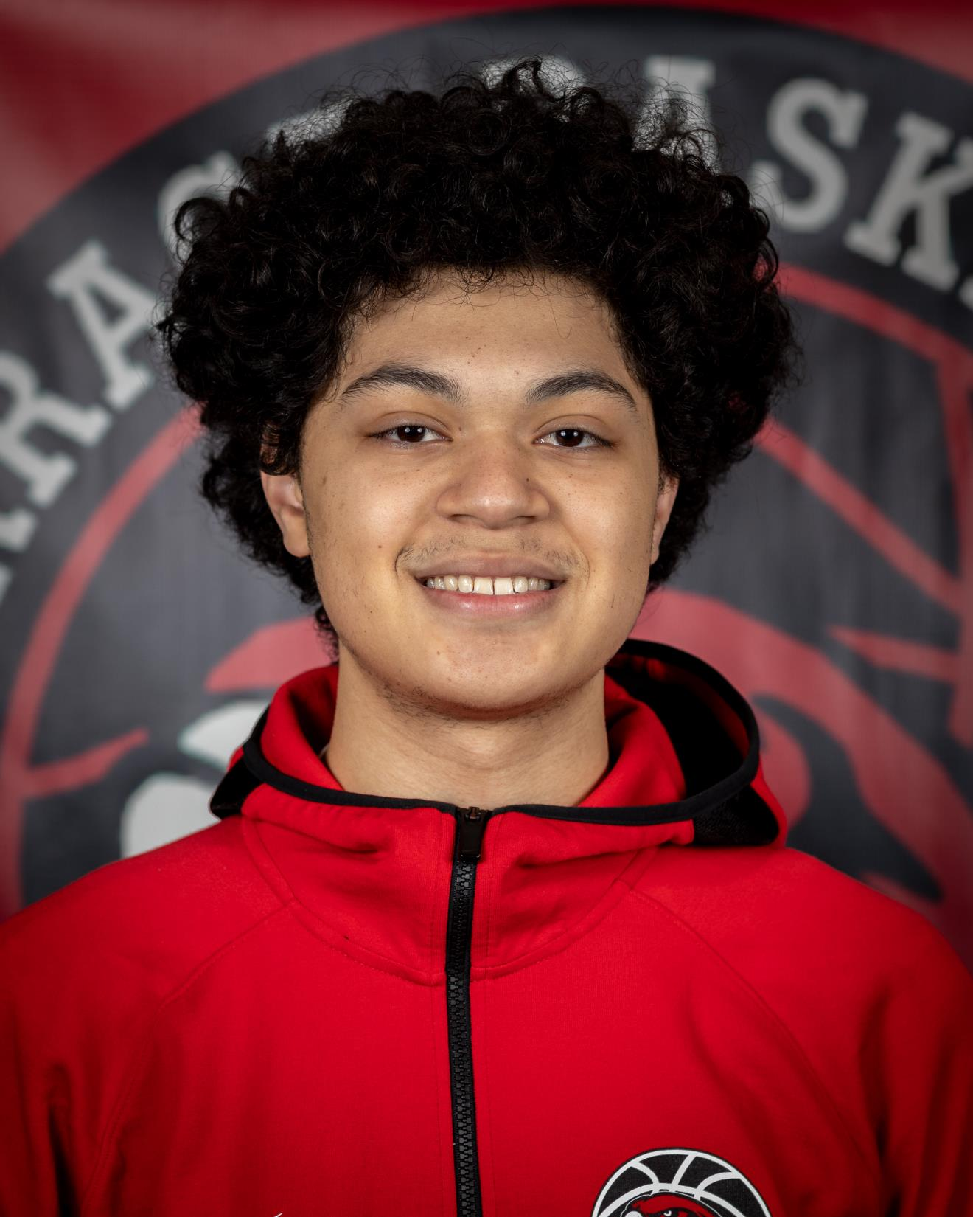
DON BROWN

Slide 8
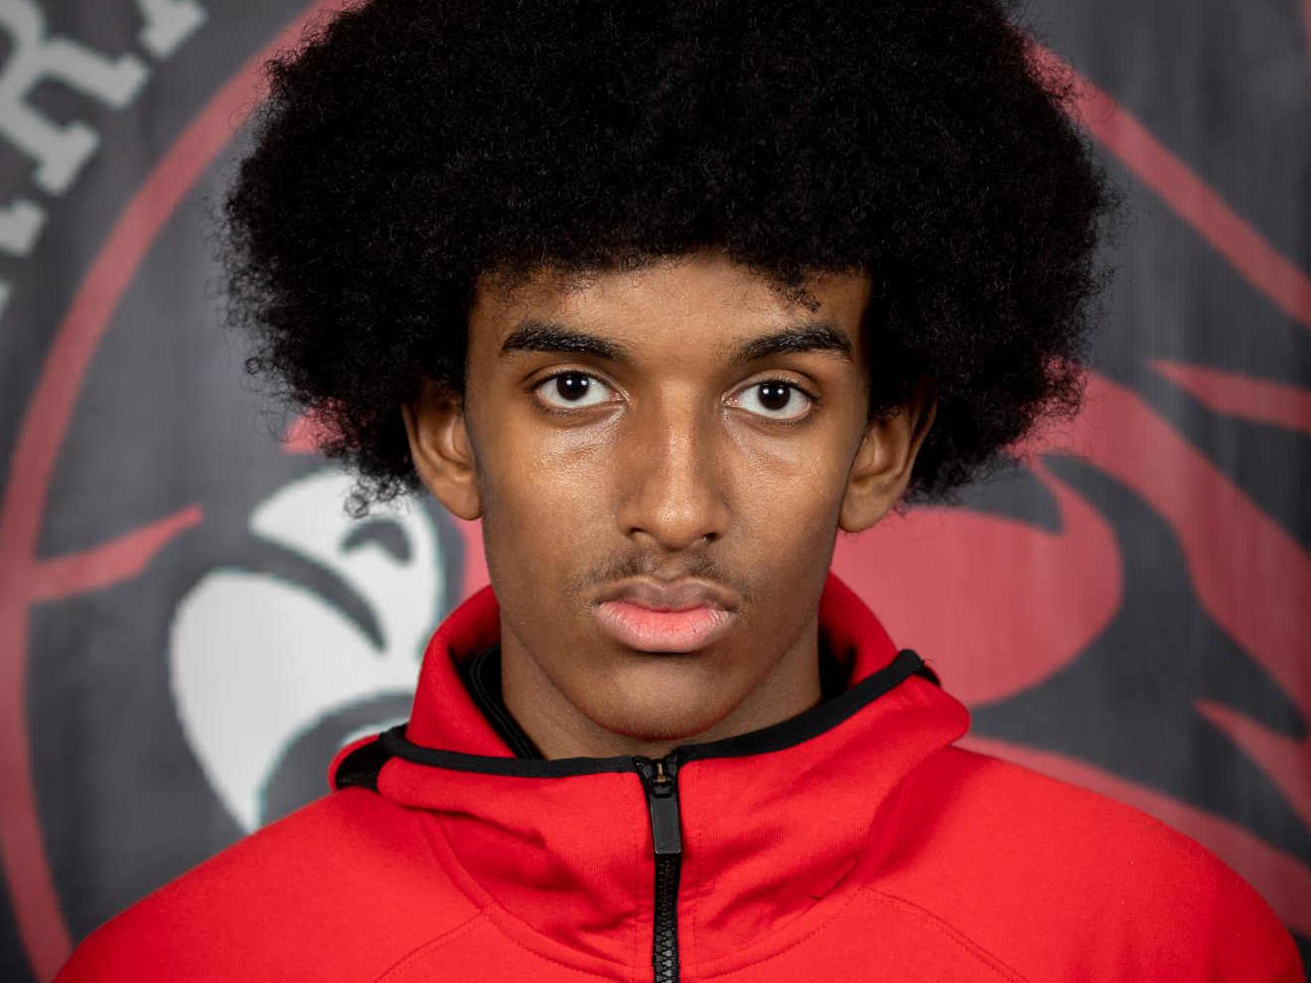
JOE ASALIFEW

Slide 9
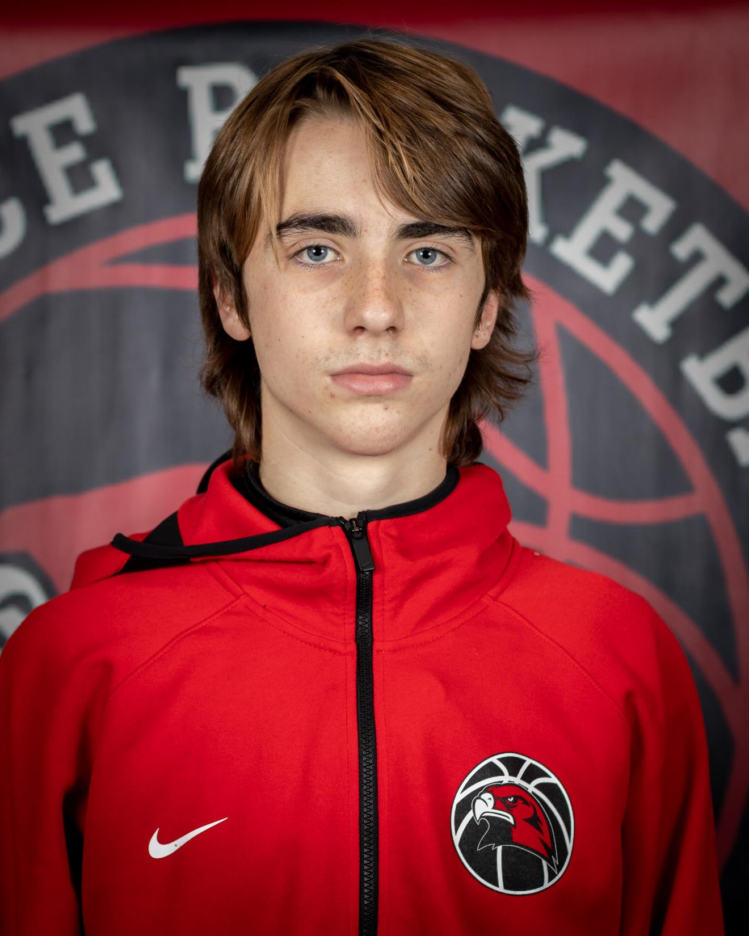
GABE TOWNE

Slide 10
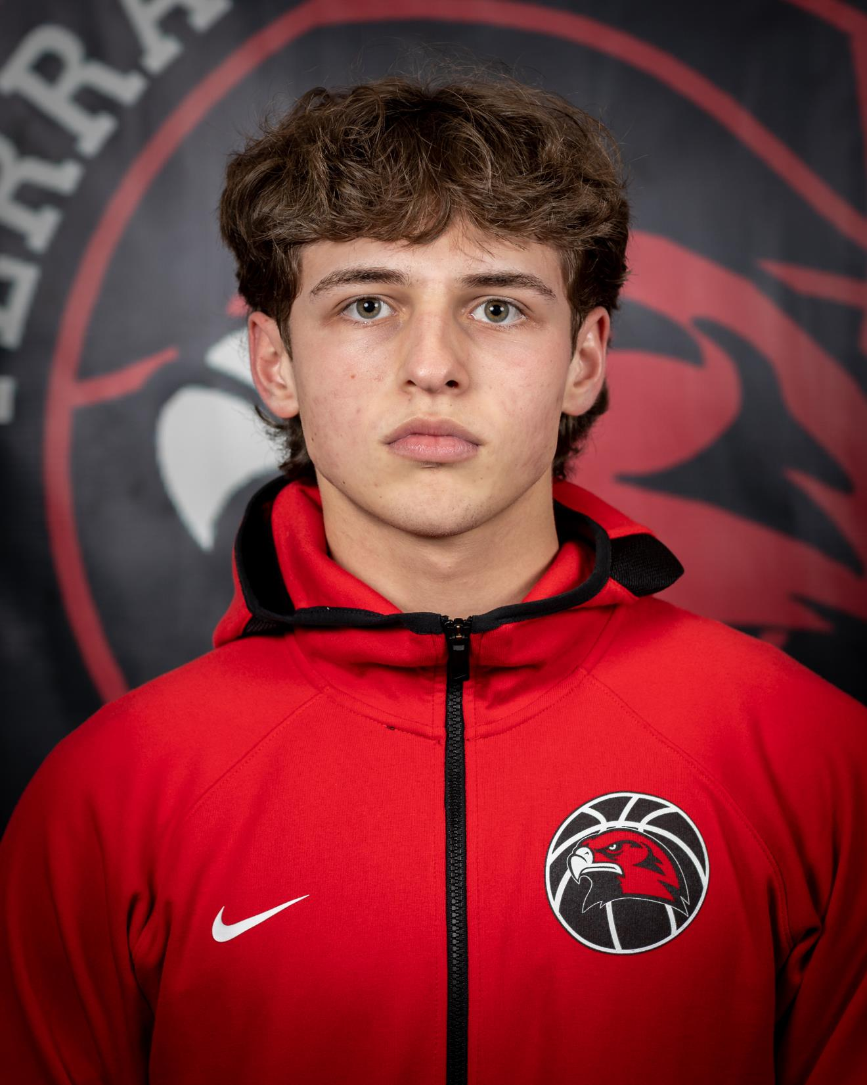
TALAN ZENK

Slide 11
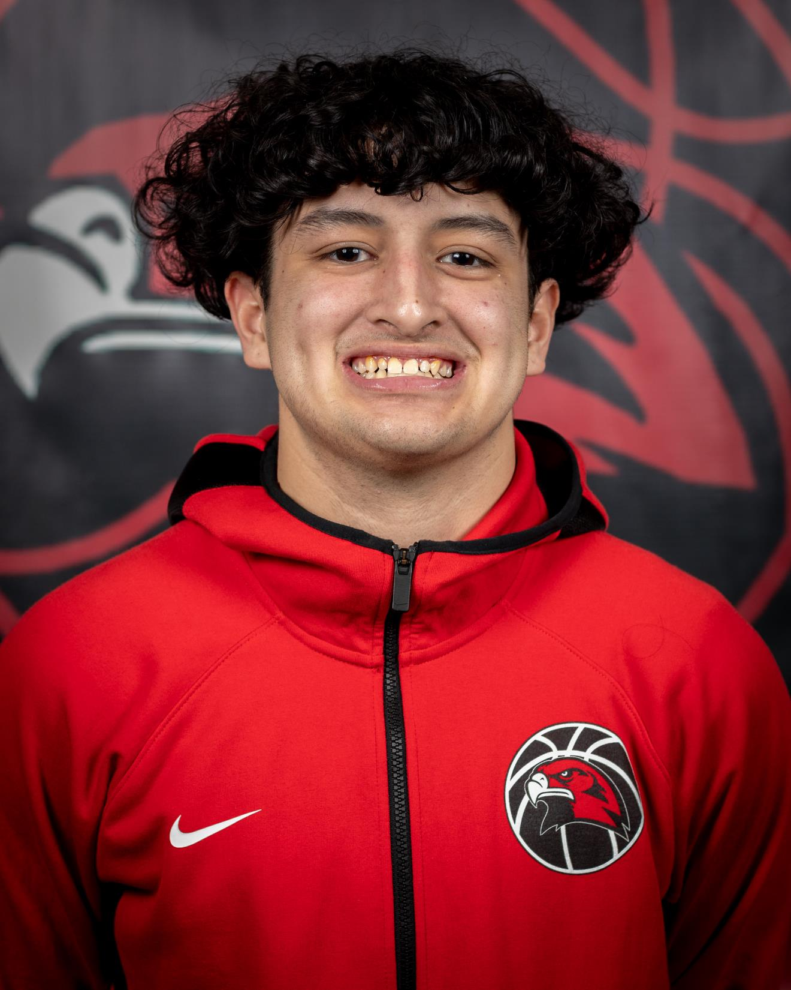
LOGAN TEWS

Slide 12
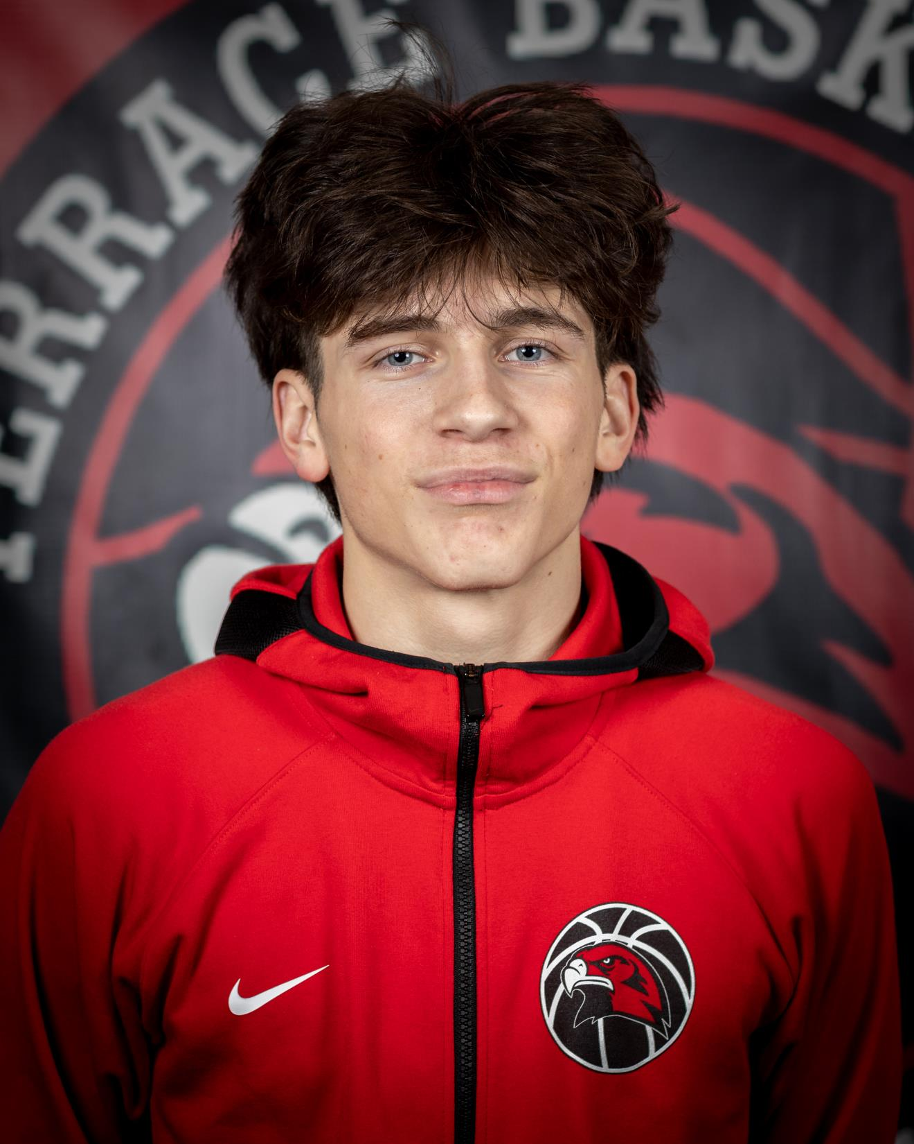
JAXON DUBIEL

Slide 13
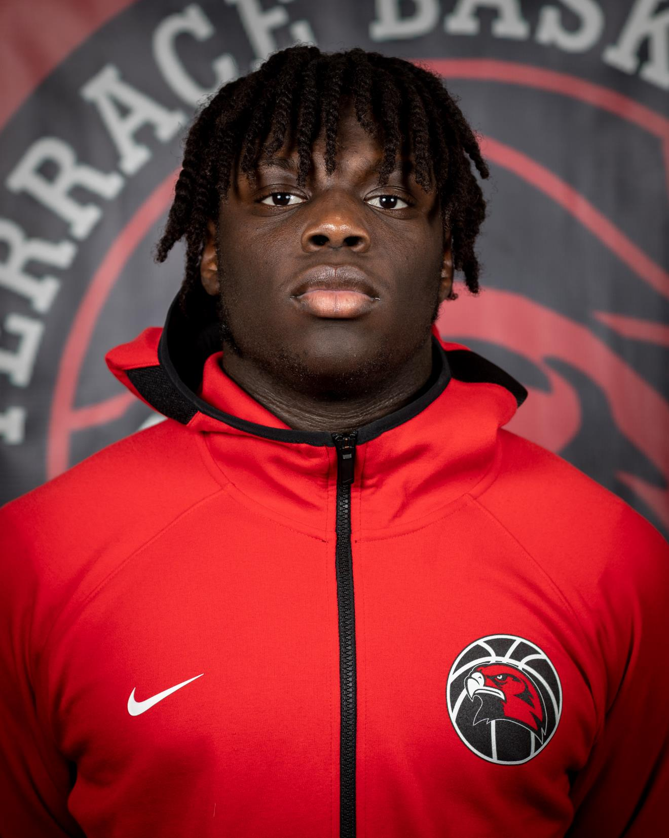
ZAVEON JONES

Slide 14
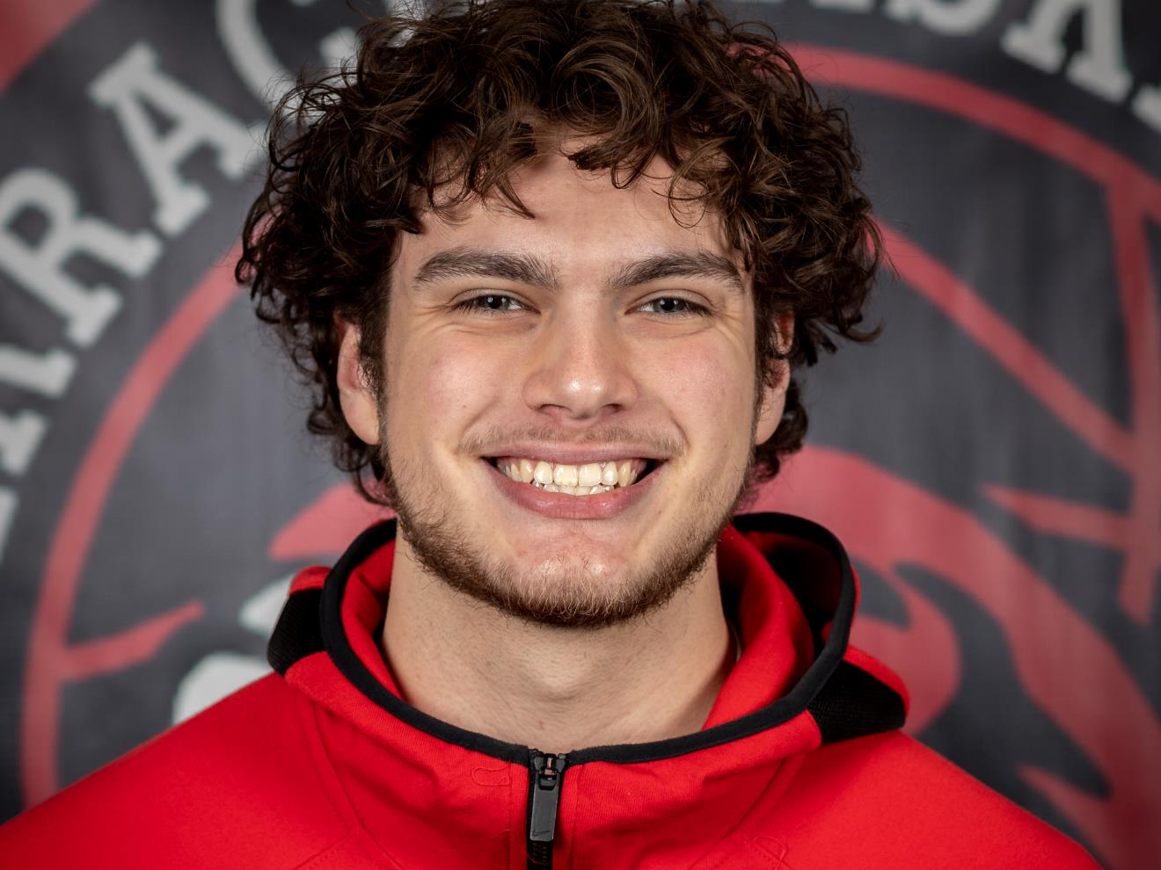
ANDEW DELGADILLO

Slide 15
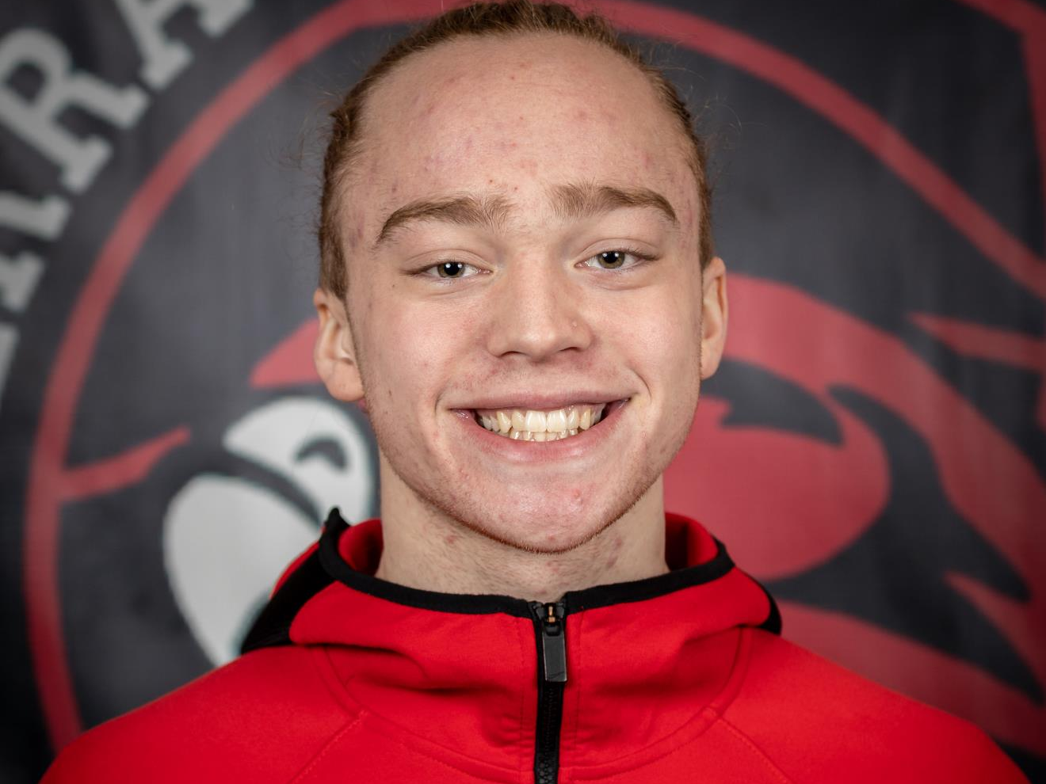
NIC SYLVESTER

Slide 16
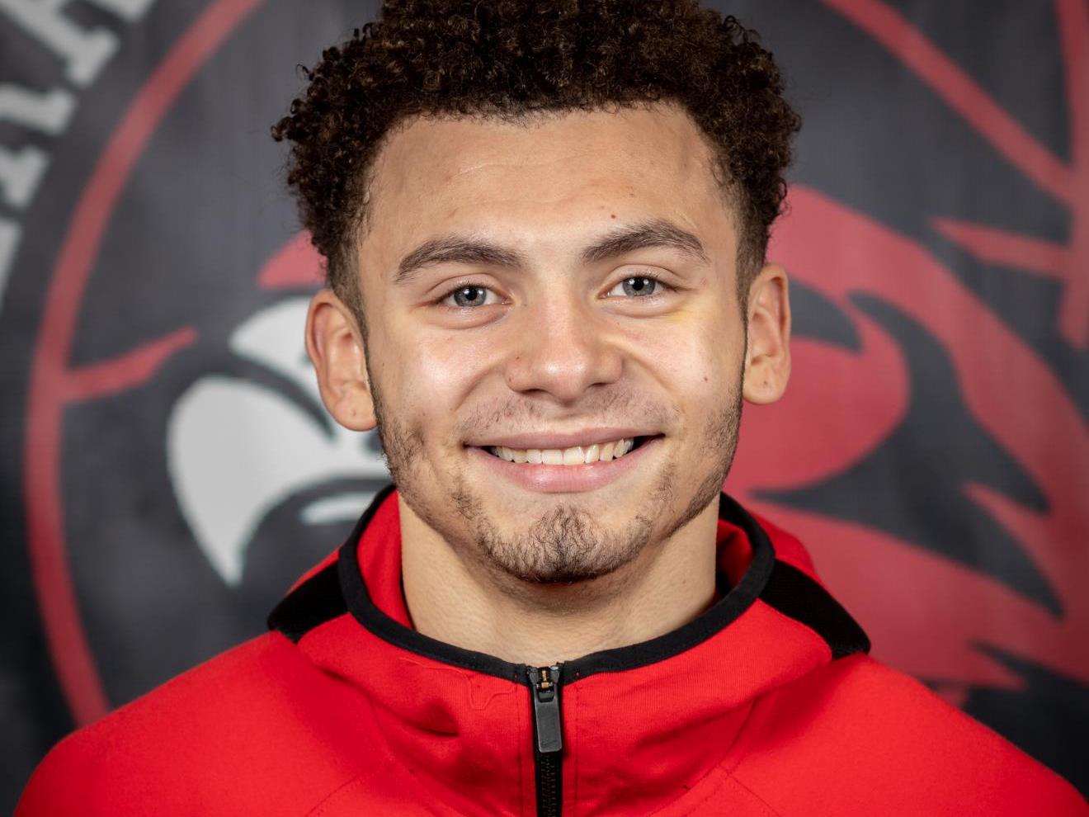
CHRIS MEEGAN

Slide 17
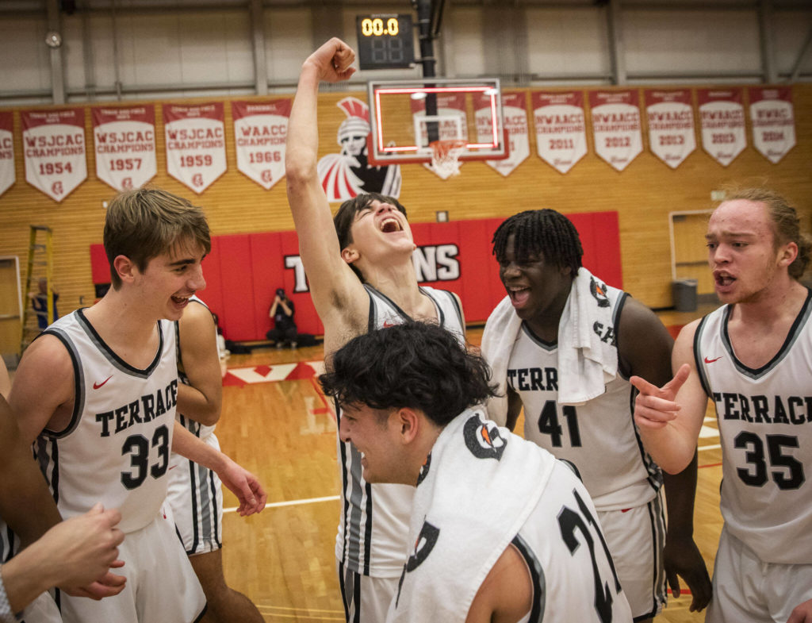
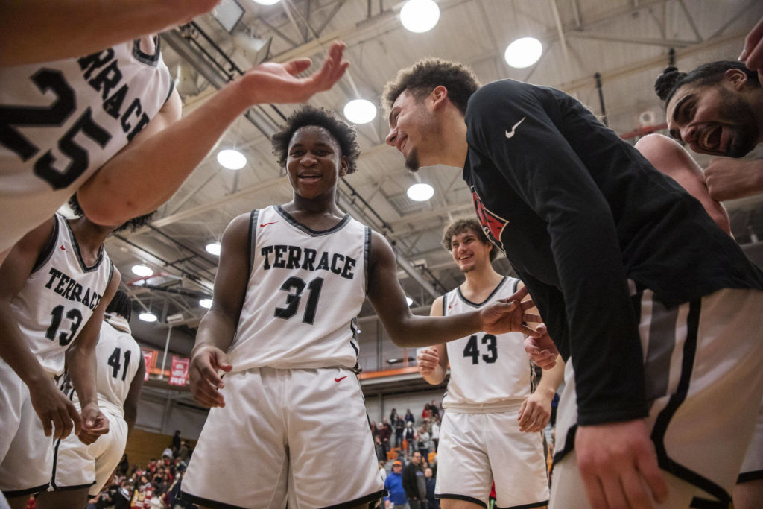

Slide 18
2022-2023 HIGHLIGHT VIDEO

